Slide 1


On the token distance modeling ability of higher RoPE attention dimension
EMNLP 2024
Notes:
Hi! My name is Xiangyu Hong and I’m from Tsinghua University. It is an honor to share our work with you. Our work digs into the dimension of rotary position embedding and find out the impact of the dimensions.

Slide 2
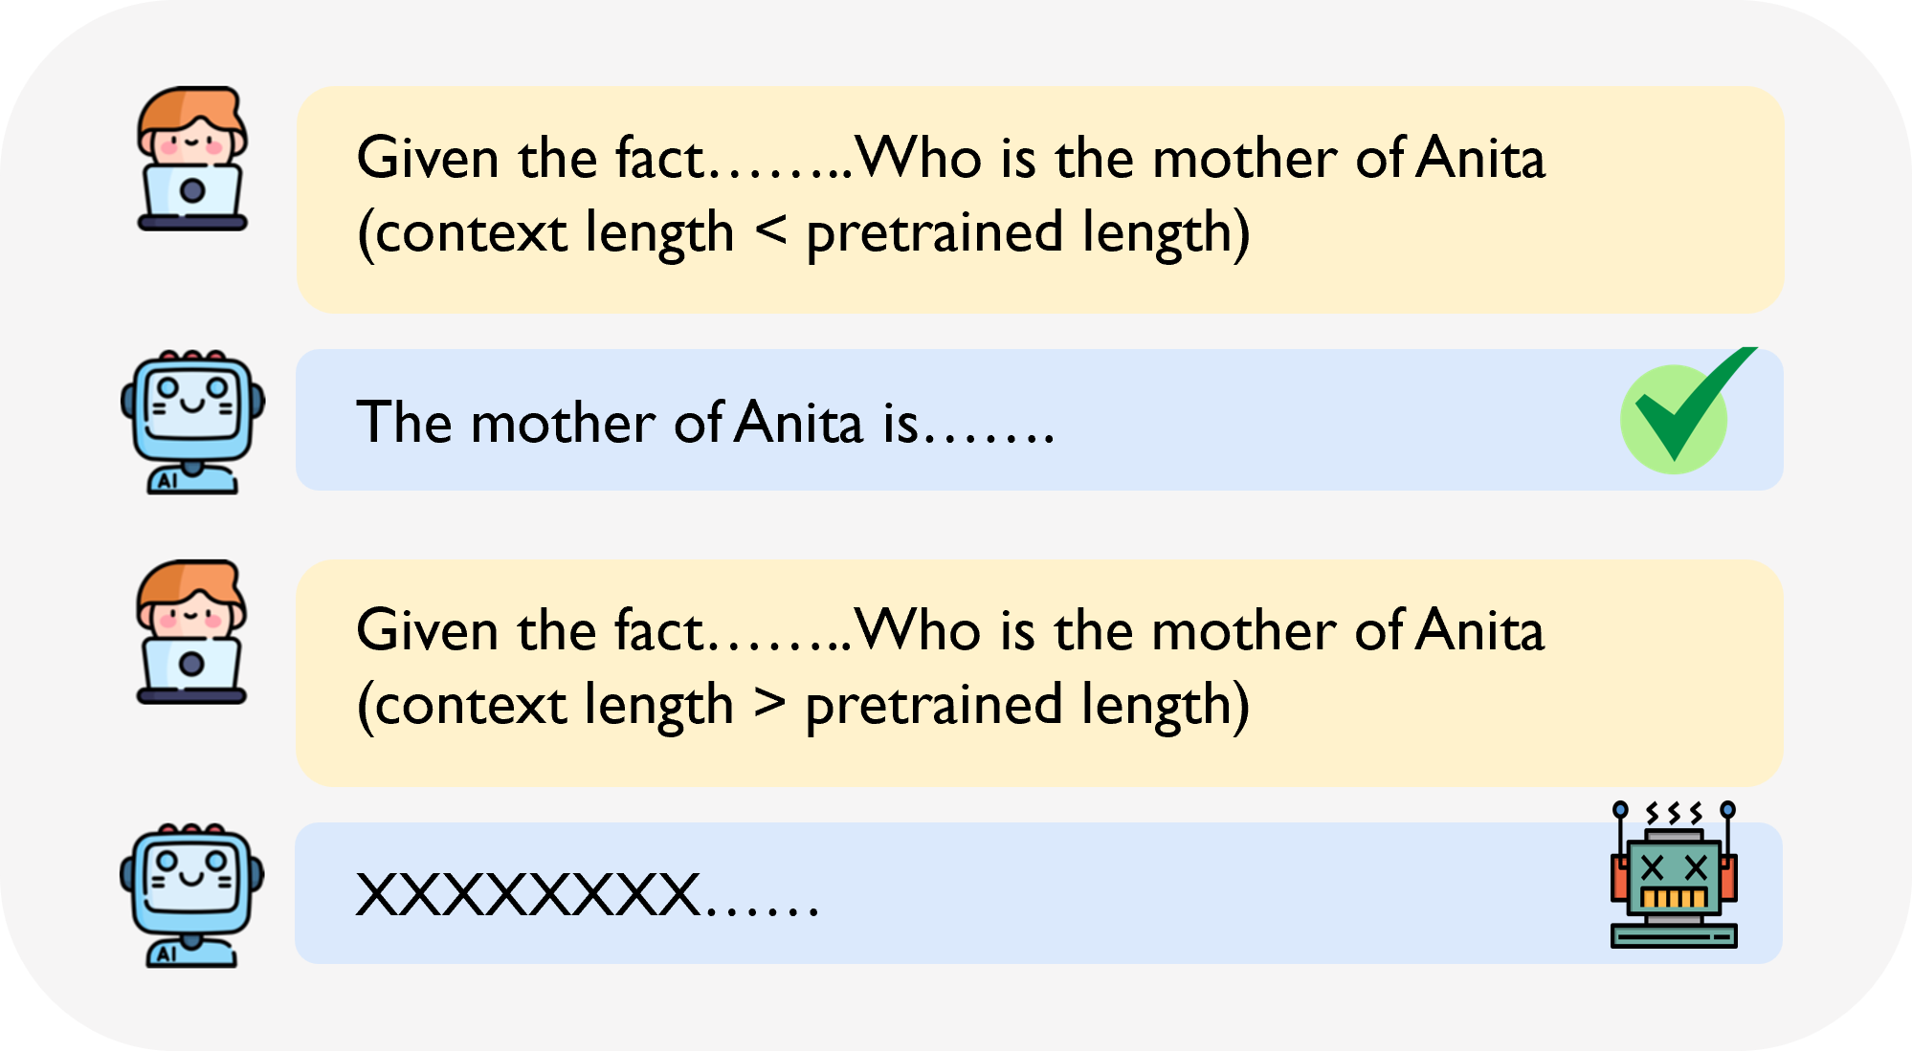

Transformer-based models struggle with long sequences.
Sequences longer than the pre-trained length of the model can lead to garbled output.
Notes:
The Transformer model has revolutionized natural language processing tasks, but it demonstrates limitations in modeling long sequences.
Consequently, there has been a recent surge of work focused on extending the context length in language models based on the Transformer architecture.

Slide 3
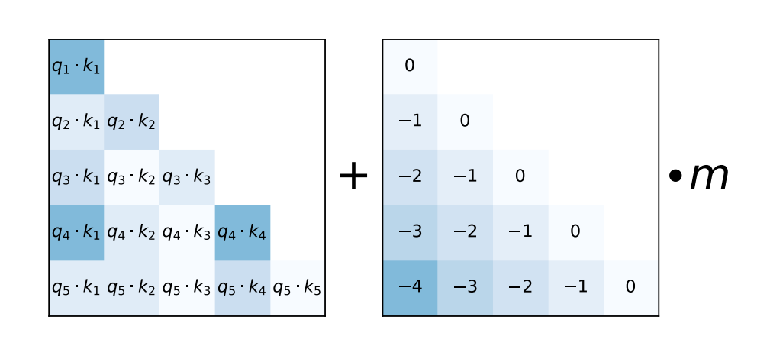
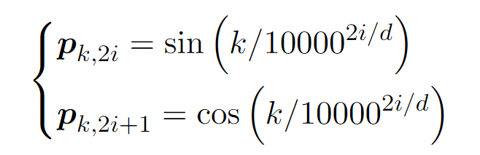
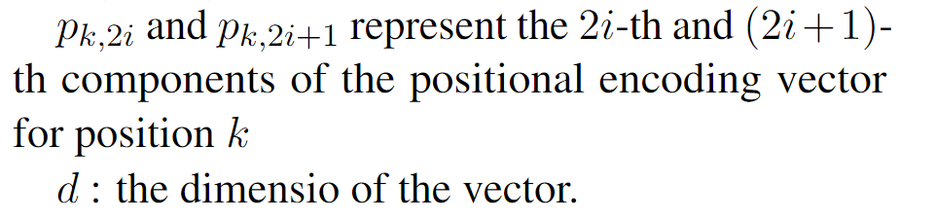
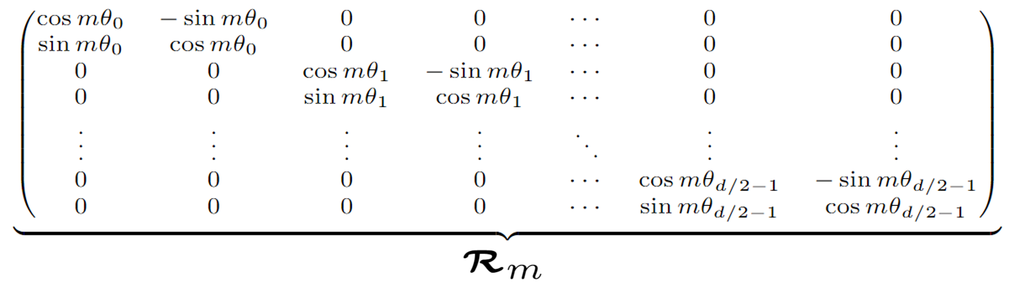
Background: Postion Encoding
Using positional encoding to incorporate the order of elements in the sequence has become a common practice in Transformer models.
APE : Absolute Position Encoding
RPE : Relative Position Encoding
Alibi
Sinusidal
RoPE
[1] Vaswani, Ashish et al. “Attention is All you Need.” Neural Information Processing Systems (2017).
[2] Press, O., Smith, N.A., & Lewis, M. (2021). “Train Short, Test Long: Attention with Linear Biases Enables Input Length Extrapolation.” (ICLR2022)
[3] Su, J., Lu, Y., Pan, S., Wen, B., & Liu, Y. (2021). RoFormer: Enhanced Transformer with Rotary Position Embedding. ( Neurocomputing)
Mainstream for LLMs
Notes:
Models need to effectively manage token positions, but due to the permutation invariance of Transformers, they struggle to capture positional information directly. Thus, positional encoding has become essential.
Positional encodings can be divided into absolute and relative types.
Sinusoidal encoding, introduced in "Attention is All You Need," exemplifies absolute encoding.
Recently, many large language models have shifted towards relative position encodings, which account for the distances between tokens in attention calculations. Notable relative encodings include Alibi, which uses a bias matrix, and RoPE, which employs rotation matrices while maintaining an absolute format. RoPE's strong performance has made it a widely adopted method, used in models like LLaMA and Mistral.

Slide 4
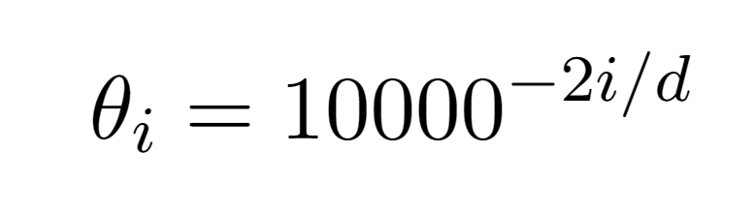
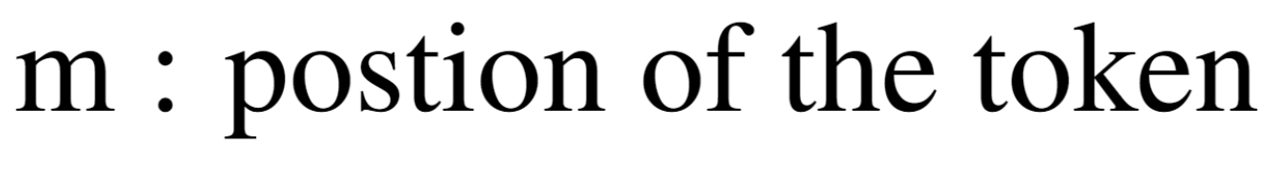
Background: RoPE (Rotary Position Embedding)
The rotary matrix for token at position m
Higher
dimension
lower
frequency
Su, J., Lu, Y., Pan, S., Wen, B., & Liu, Y. (2021). RoFormer: Enhanced Transformer with Rotary Position Embedding. ( Neurocomputing)
Notes:
RoPE achieves relative position encoding using rotation matrices for even dimensions d.
For a token at position m, we define a rotation matrix as shown in the slide, and theta_i = 10000^{-2i/d}.(equals ten thousand to the power of negative two times i divided by d.)
Based on the value of theta, it can be observed that in the rotation matrix, higher dimensions correspond to a lower rotation frequency.

Slide 5
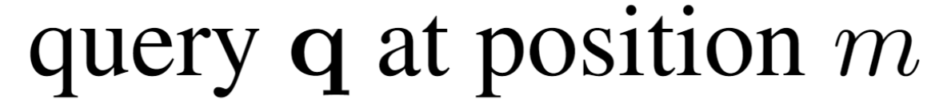
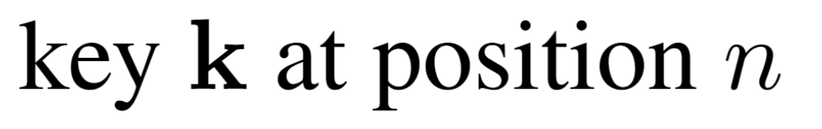
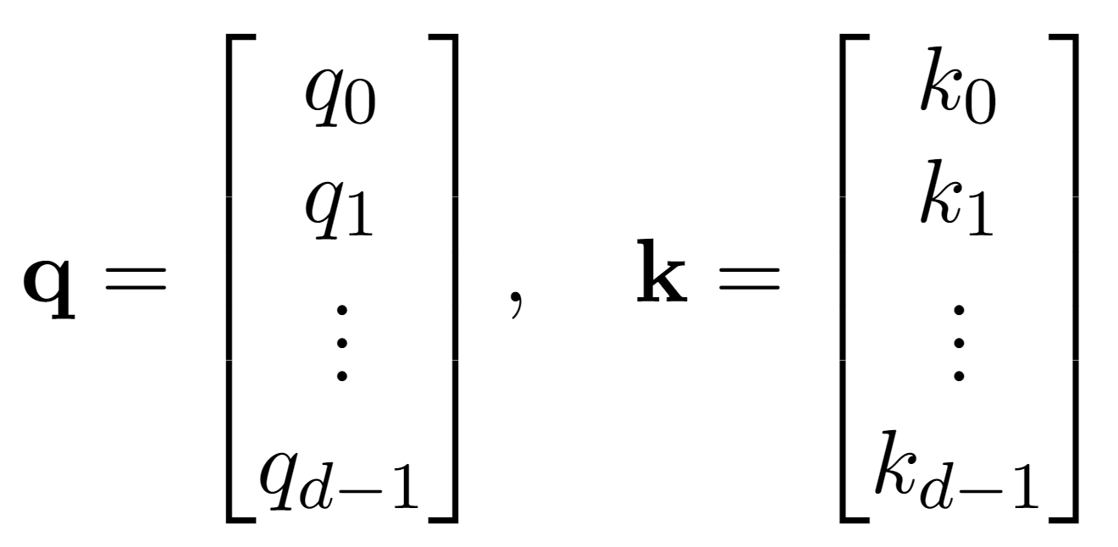
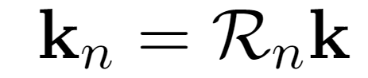
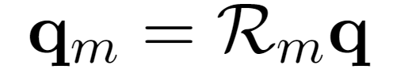
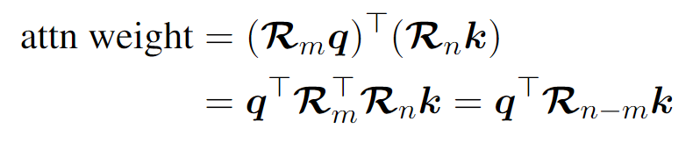
Background: RoPE (Rotary Position Embedding)
Su, J., Lu, Y., Pan, S., Wen, B., & Liu, Y. (2021). RoFormer: Enhanced Transformer with Rotary Position Embedding. ( Neurocomputing)
Notes:
When calculating attention weights for a query at position m and a key at position n, we apply their respective rotation matrices.
Then we compute the attention weight as specified in the formula. The properties of the rotation matrix ensure that this transformation corresponds to the rotation matrix for n – m (minus ), effectively facilitating relative position encoding.

Slide 6
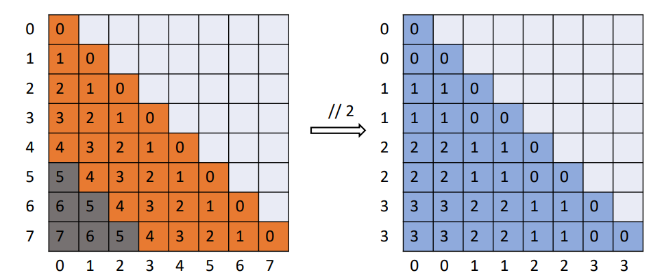
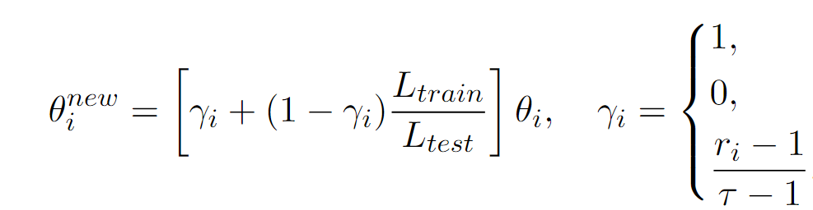
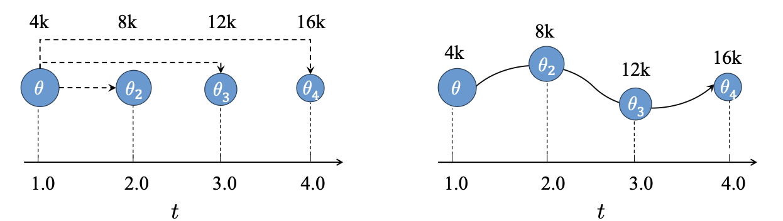
Related work：Length extrapolation methods without further training
Yarn
CLEX
Self-Extend
By interpolating the high-dimensional low-frequency components of RoPE while leaving the low-dimensional high-frequency parts unchanged, length extrapolation is achieved.
CLEX assigns different θ_i for each position, treating θ_i(pos) as a continuous function of position. It models this function using a neural ODE, fine-tuning the parameters to achieve better results.
This approach employs rounding operations to convert each relative position into an integer.
Peng, Bowen et al. “YaRN: Efficient Context Window Extension of Large Language Models.” ICLR2024
Chen, Guanzheng et al. “CLEX: Continuous Length Extrapolation for Large Language Models.” ICLR2024
Jin, Hongye et al. “LLM Maybe LongLM: Self-Extend LLM Context Window Without Tuning.” ICML2024
Notes:
Currently, several works focus on training-free length extrapolation methods for RoPE-based large language models, with notable representatives including Yarn, CLEX, and Self-Extend.
Yarn achieves extrapolation by interpolating theta of high-dimension, low-frequency components of theta in RoPE.
CLEX treats theta_i as a continuous function of token positions and uses a neural ODE to model this function.
Self-Extend operates on relative positions by interpolating them and rounding to facilitate length extrapolation.

Slide 7
Take-away Messages
High-dimensional components of RoPE with low frequency have a greater impact than low-dimensional high-frequency components.
Exceeding pre-training input lengths causes high-dimensional anomalies, while length extrapolation methods extend high-dimensional attention allocation over longer distances.
Attention heads with strong token-distance and dimension correlation, called Positional Heads, are key for modeling text distances.
On the token distance modeling ability of higher RoPE attention dimension
Xiangyu Hong, Che Jiang, et al. & Mo Yu, Bowen Zhou. EMNLP 2024 findings
Notes:
Some works address various treatments of dimensions in RoPE for training-free length extrapolation, but the specific roles of each dimension in RoPE for long-text semantic modeling remain unclear. Thus, we investigate the dimensional aspects of RoPE to understand the significance of different dimensions in semantic modeling.
Here are the Take-away messages for my talk.
First, in most attention heads, regardless of whether length extrapolation is performed, the impact of high-dimension low-frequency components is greater than that of low-dimension high-frequency components.
Second, input lengths exceeding the pre-training length can result in anomalies in high-dimension components. Length extrapolation extends the high-dimension attention allocation for a longer token distance.
Third, we refer to attention heads with stronger correlation between token distance and dimension allocation as Positional Heads, which play a crucial role in modeling text distances.

Slide 8
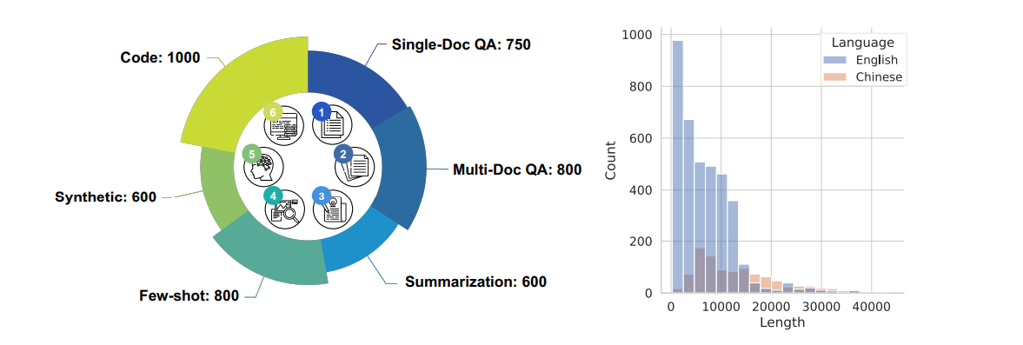
Dataset & Model for Analysis
Dataset: LongBench
Model: Llama2-7B-chat, Mistral-7B
Commonly used for length extrapolation methods
We use greedy decoding strategy for consistency
Extrapolation methods: Yarn, CLEX, self-extend
Using several representative methods
Achieve State-of-the-art performance
Bai, Yushi et al. “LongBench: A Bilingual, Multitask Benchmark for Long Context Understanding.” (ACL2023)
On the token distance modeling ability of higher RoPE attention dimension
Xiangyu Hong, Che Jiang, et al. & Mo Yu, Bowen Zhou. EMNLP 2024 findings
Notes:
We use the LongBench dataset for our research, which includes multiple tasks such as question answering and code completion, and supports both Chinese and English languages.
Our primary focus is on the LLaMA-2-7B-Chat and Mistral-7B models, as they are currently popular choices for training-free length extrapolation.
For the training-free length extrapolation methods, we specifically examine Yarn, CLEX, and Self-Extend, primarily because they each employ distinct, representative approaches and have demonstrated good performance in our tests.
We use a greedy decoding strategy to ensure consistency in our analysis

Slide 9
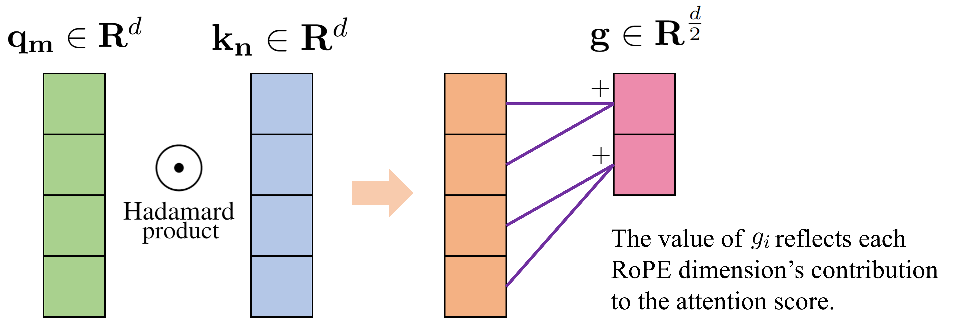
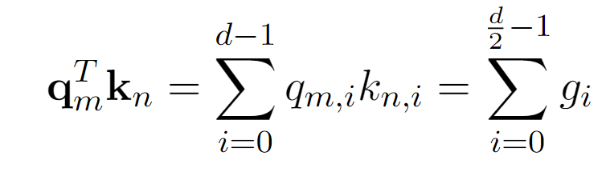
Definition: Dimension contribution of RoPE
On the token distance modeling ability of higher RoPE attention dimension
Xiangyu Hong, Che Jiang, et al. & Mo Yu, Bowen Zhou. EMNLP 2024 findings
Notes:
We define the contribution of each dimension in RoPE to the attention weight, which we refer to as "dimension contribution."
For a query at position m, after applying the corresponding rotation matrix, we obtain q_m, and for a key at position n, we get k_n.
We then compute their Hadamard product. Due to the fact that in the rotation matrix, each pair of dimensions shares the same theta_i, corresponding to the same rotation frequency, we can sum these two dimensions to produce a new vector of size half of d, where each value represents the contribution of the corresponding RoPE dimension to the attention weight.

Slide 10
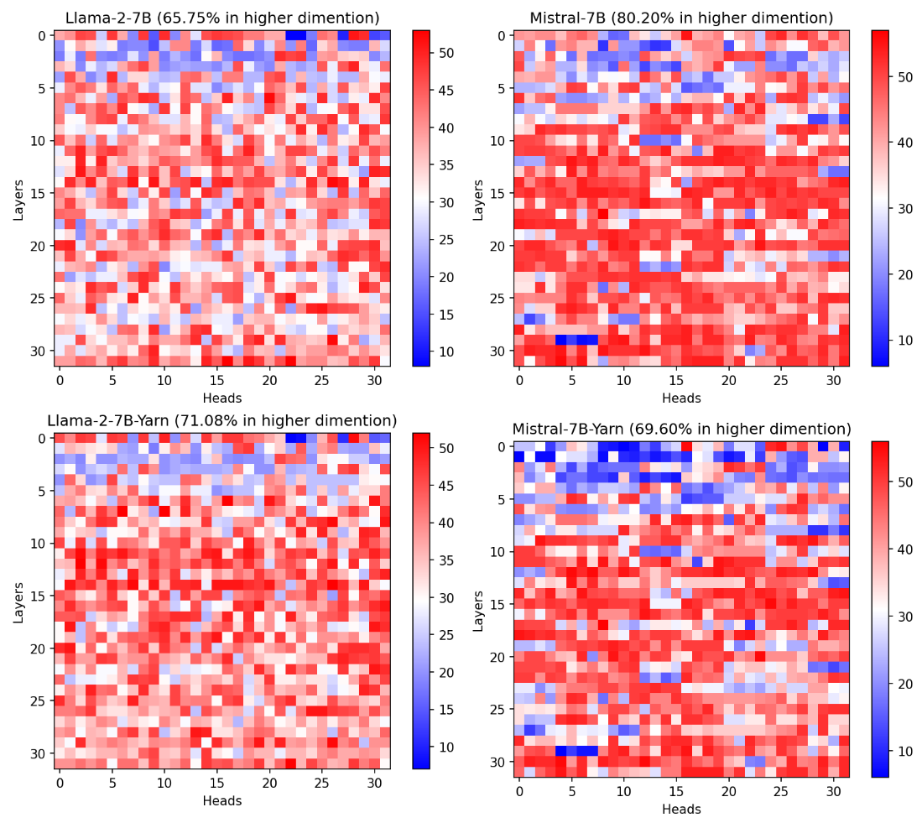
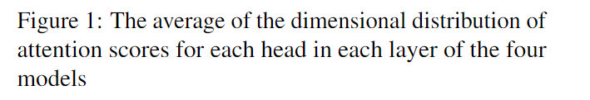
Are there distinct patterns of attention contributions across different dimensions?
Sampled 17 inputs from LongBench
Each input, each layer and each head of the model, we randomly selected 100 number of tokens qk pairs.
Each selected qk pair, we recorded top 5 dimensions contributed most.
Higher dimensions of RoPE contribute more to the attention weights.
On the token distance modeling ability of higher RoPE attention dimension
Xiangyu Hong, Che Jiang, et al. & Mo Yu, Bowen Zhou. EMNLP 2024 findings
Notes:
First, we examined whether there are differences in the contributions of different dimensions in RoPE to the attention weights.
We sampled 17 inputs, and for each input, we randomly selected 100 qk pairs for each attention head in the model. For each qk pair, we calculated the dimension contribution of each RoPE dimension and recorded the top 5 dimensions with the highest contributions. Since the dimension of qk in the LLaMA-2-7B-chat model is 128, the defined dimension contributions amount to a total of 64 dimensions.
The experimental results indicate that the majority of attention heads primarily derive their attention scores from higher-dimension components.
And in the shallow layers, consistent with previous studies, models tend to focus on syntactic parsing, placing greater emphasis on shorter-distance information. As a result, the lower-dimension components of RoPE contribute more to the attention weights.
Notably, we did not observe significant changes in the dimension distribution before and after length extrapolation.

Slide 11
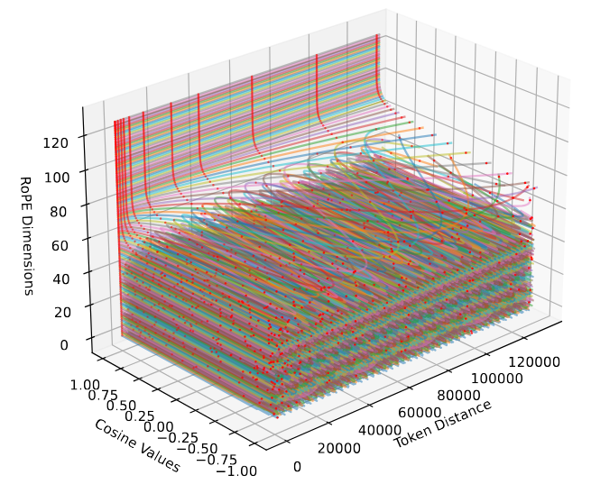
Potential explanation for the higher contribution observed in the higher-dimensional components
Colored lines: The value of trigonometric function in rotation position coding changes with the dimension and token distance
Red dots: the trigonometric function value of different dimension corresponding to some specific token distance
Higher dimensions of RoPE can more effectively distinguish long-range dependencies.
On the token distance modeling ability of higher RoPE attention dimension
Xiangyu Hong, Che Jiang, et al. & Mo Yu, Bowen Zhou. EMNLP 2024 findings
Notes:
We give a potential explanation for the higher contribution observed in the higher-dimension components
The effect of the rotary position embedding matrix on positions n and m in dimension i can be described by the function cos((n - m)theta_i)(cos of (n minus m) and multiply theta_i). Our visualization reveals irregularities in lower dimensions due to the higher frequencies of these functions.
RoPE is designed to encode varying token distances across dimensions, with attention scores aggregating this information. However, the irregularities in lower dimensions complicate the disentangling of distance-related information, leading the model to favor higher dimensions during training. These higher dimensions also affect the maximum text length the model can handle.
By increasing the base of the exponential function in theta_i, we can reduce the frequency of the trigonometric functions, enhancing the distinguishability of higher-dimension components. This approach has been effective in pre-training models like LLaMA3 and Code-Llama.

Slide 12
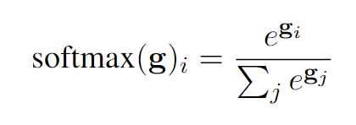
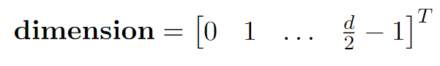
Are higher dimensions responsible for long-range attention among tokens?
Definition: Dominant Dimension
Dominant Dimension
Softmax
Dot product
Dimension vector
On the token distance modeling ability of higher RoPE attention dimension
Xiangyu Hong, Che Jiang, et al. & Mo Yu, Bowen Zhou. EMNLP 2024 findings
Notes:
To explore whether higher dimensions drive long-range attention, we introduce the concept of the dominant dimension—defined as the dimension contributing most to attention weights.
To calculate this, we first apply the softmax function to handle potential negative values in the dimension contributions, then multiply the result by the dimension vector to determine the dominant dimension.

Slide 13
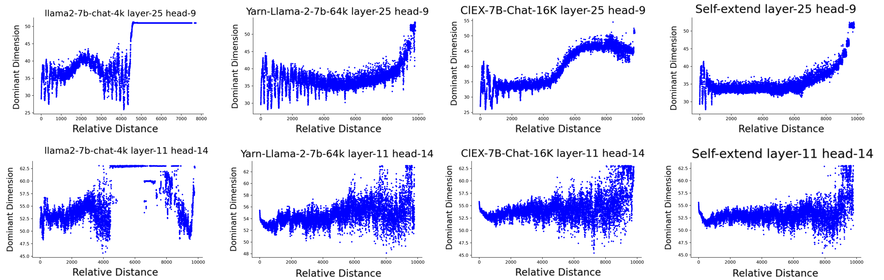
Are higher dimensions responsible for long-range attention among tokens?
Observation
Correlation plot between token relative distances and the dominant dimension
On the token distance modeling ability of higher RoPE attention dimension
Xiangyu Hong, Che Jiang, et al. & Mo Yu, Bowen Zhou. EMNLP 2024 findings
Notes:
Next, we further explored the relationship between the dominant dimension and relative distance. We analyzed the correlation between these two elements for each head in the model and obtained the following results:
First, in certain heads of the model, we find a significant correlation between the dominant dimension and the relative distance, while this correlation is absent in other heads.
Second, for the original Llama model, we observe a sudden change in the dominant dimension when the sequence length exceeds the pretraining length of 4K. A similar phenomenon has been noted in other models, such as Baichuan.
Third, regarding the length extrapolation method, by examining the dominant dimension of the model, we see that this method extends the trend of the dominant dimension observed within the pretraining length range of Llama to a new length range, thereby facilitating length extrapolation. This finding aligns with the design principles underlying these length extrapolation approaches.

Slide 14
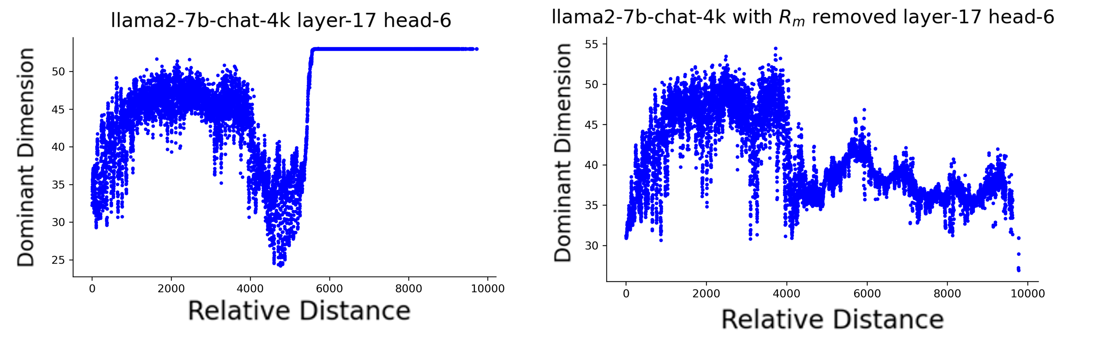
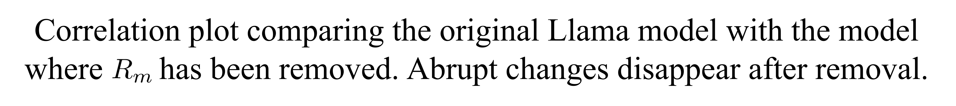
Are higher dimensions responsible for long-range attention among tokens?
OOD Explanation
On the token distance modeling ability of higher RoPE attention dimension
Xiangyu Hong, Che Jiang, et al. & Mo Yu, Bowen Zhou. EMNLP 2024 findings
Notes:
To further explain the sudden change in behavior of the original model when exceeding the pretraining length, we conducted an ablation study on the dimension matrix R_m of the rotary position encoding. The results, as shown, indicate that when the length is less than the pretraining threshold of 4K, the output after removing R_m shows minimal differences compared to the original. However, beyond this pretraining length, we observe no abrupt changes.
We propose a plausible explanation based on these findings: as the relative distance increases, the lower dimensions of the rotary positional embedding begin to exhibit characteristics akin to random sampling, while the higher dimensions remain relatively stable. Consequently, when the relative position exceeds the pretraining length of 4K, the values in the lower dimensions become increasingly overshadowed by noise from the trigonometric functions, while the values in the higher dimensions remain consistent.
The model's training adapts to this sampling behavior of the trigonometric functions; however, once the relative distance surpasses the pretraining length, the model struggles to adjust to this extended sampling range. This results in a loss of coherence in the lower dimensions, while the influence of the higher dimensions becomes dominant.

Slide 15
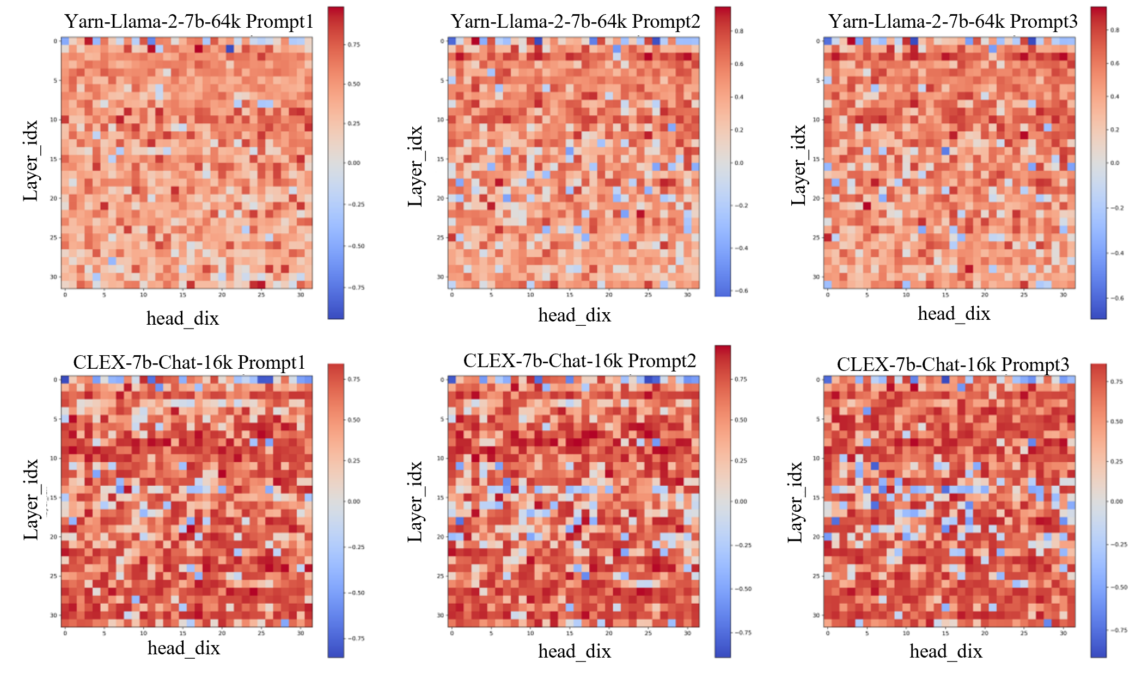
Finding the Positional Heads
Positional Heads Detection
Spearman correlation coefficients of each head in the YaRN-Llama-2-7b-64K model and CLEX-7B-chat-16K across different prompts.
There is a notable correlation between the dominant dimension and the relative distance in most heads.
On the token distance modeling ability of higher RoPE attention dimension
Xiangyu Hong, Che Jiang, et al. & Mo Yu, Bowen Zhou. EMNLP 2024 findings
Notes:
We define heads that show a strong correlation between the dominant dimension and relative distance as Positional Heads. To identify these Positional Heads, we first calculated the Spearman correlation coefficients for these two factors within each head, and the results are illustrated in the figure.
Next, based on the Spearman correlation coefficients, we selected the top 5%(percent) and top 10% positional heads, as well as randomly selected 5% and 10% of heads, to conduct ablation experiments. The results of these experiments are presented below.

Slide 16
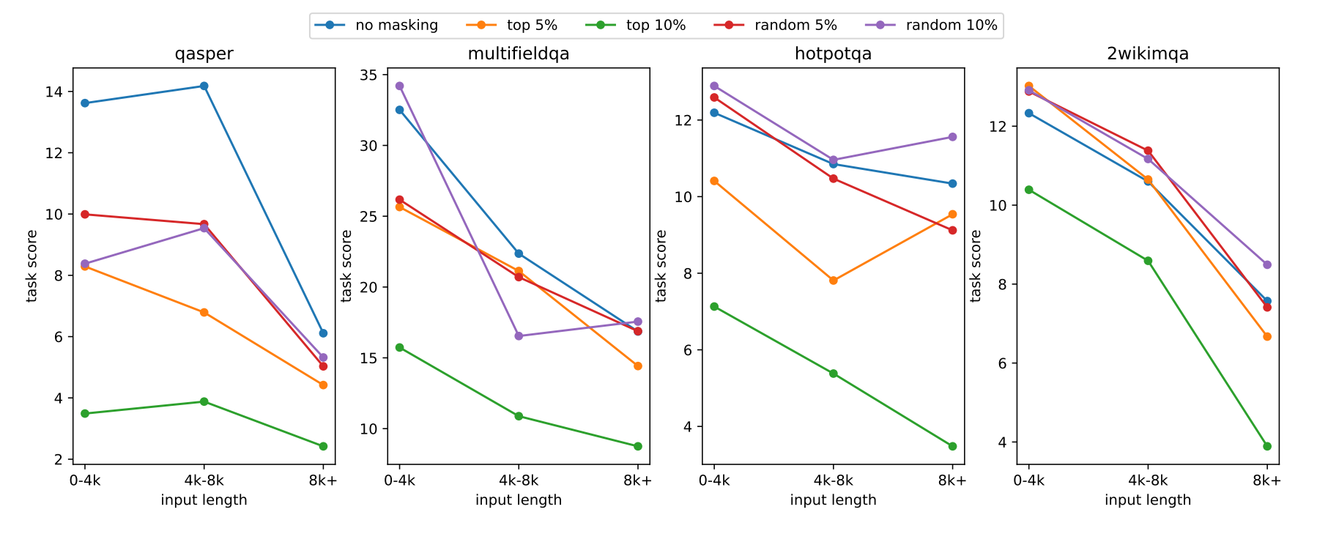
Ablating Positional Heads
Influence of Positional Heads on long distance modeling - Question Answering task
Masking out top scored heads v.s. random heads. For the QA tasks in LongBench, the removal of heads with top scores clearly reduces performance.
On the token distance modeling ability of higher RoPE attention dimension
Xiangyu Hong, Che Jiang, et al. & Mo Yu, Bowen Zhou. EMNLP 2024 findings
Notes:
First, we conducted ablation experiments on four QA tasks from LongBench. We use Yarn models for study. Results show a significant performance drop when masking Positional Heads.

Slide 17
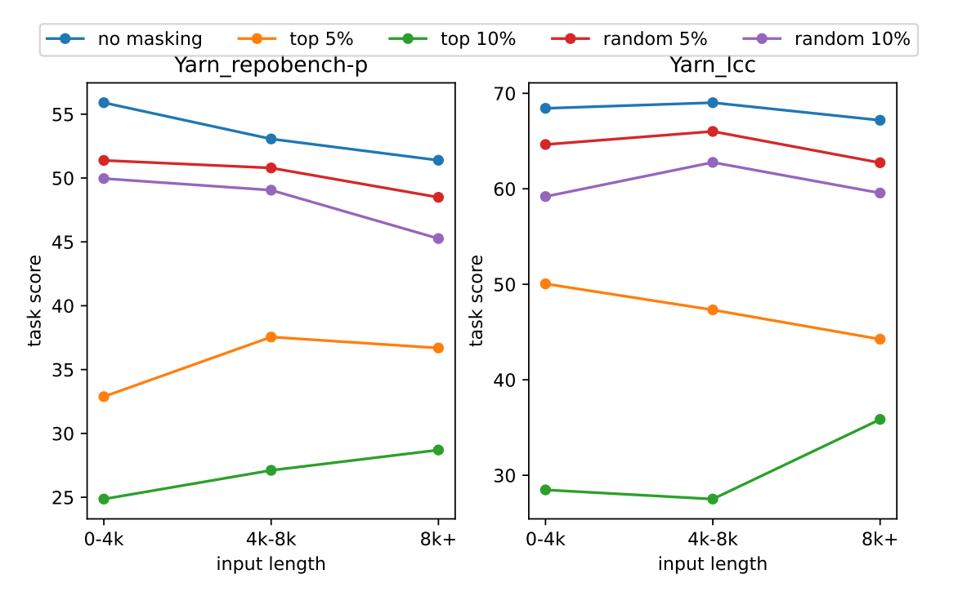
Ablating Positional Heads
Influence of Positional Heads on long distance modeling - Code Completion
Masking out top scored heads v.s. random heads. For the Code tasks in LongBench, the removal of heads with top scores clearly reduces performance.
On the token distance modeling ability of higher RoPE attention dimension
Xiangyu Hong, Che Jiang, et al. & Mo Yu, Bowen Zhou. EMNLP 2024 findings
Notes:
Next, similar results were observed in the code completion task, which requires greater long-distance dependencies.

Slide 18
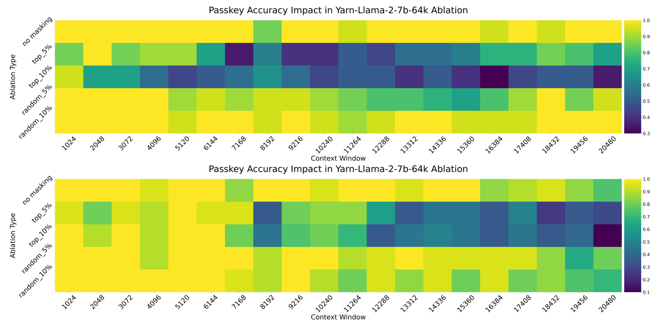
Ablating Positional Heads
Influence of Positional Heads on long distance modeling – Passkey
Masking out heads with top scores v.s. random heads. For the passkey task, the removal of heads with top scores clearly reduces performance.
On the token distance modeling ability of higher RoPE attention dimension
Xiangyu Hong, Che Jiang, et al. & Mo Yu, Bowen Zhou. EMNLP 2024 findings
Notes:
For the PassKey task, which was commonly used to evaluate long text retrieval, we tested length extrapolation method. In contrast, masking high-score attention heads in the extrapolated model leads to a uniform decline across all lengths, highlighting their sensitivity to text distance, whereas random masking does not exhibit this behavior.

Slide 19
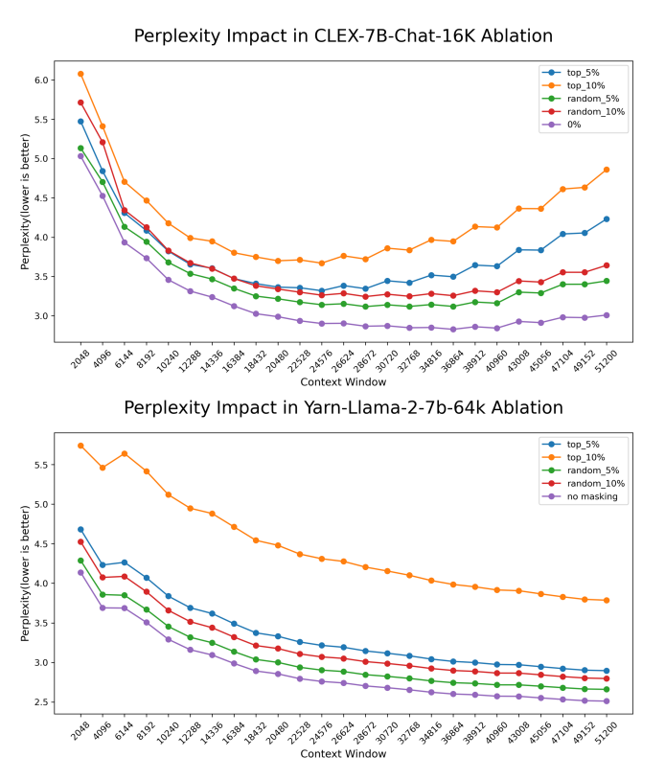
Ablating Positional Heads
Influence of Positional Heads on long distance modeling – Passkey
Masking out heads with top scores v.s. random heads. For the ppl, the removal of heads with top scores clearly reduces performance.
On the token distance modeling ability of higher RoPE attention dimension
Xiangyu Hong, Che Jiang, et al. & Mo Yu, Bowen Zhou. EMNLP 2024 findings
Notes:
Finally, we assessed the perplexity (PPL) of the models. Masking high-score attention heads increased perplexity.

Slide 20
Next Steps
How can we leverage these findings to further improve RoPE-based models’ ability in processing longer sequences?
Could we modify RoPE to enable position embeddings to handle length extrapolation effectively?
What factors contribute to the correlation between RoPE's dimension and relative distance during training, and how can we enhance its ability to process longer sequences?
On the token distance modeling ability of higher RoPE attention dimension
Xiangyu Hong, Che Jiang, et al. & Mo Yu, Bowen Zhou. EMNLP 2024 findings
Notes:
In conclusion, we offer several research questions worth considering based on our work.
First, how can we leverage these findings to further improve RoPE-based models’ ability in processing longer sequences?
Second, could we modify RoPE to enable position embeddings to handle length extrapolation effectively?
Third, what factors contribute to the correlation between RoPE's dimension and relative distance during training, and how can we enhance its ability to process longer sequences?

Slide 21
Q&A THANKS
EMNLP 2024
hong-xy22@mails.tsinghua.edu.cn
Notes:
Thank you for your listening

